Slide 1
Unit 8: 2D Arrays

AP CS A
Ms. Baniqued

Slide 2

Review
Initialize an array of any type with an initializer list.

Slide 3
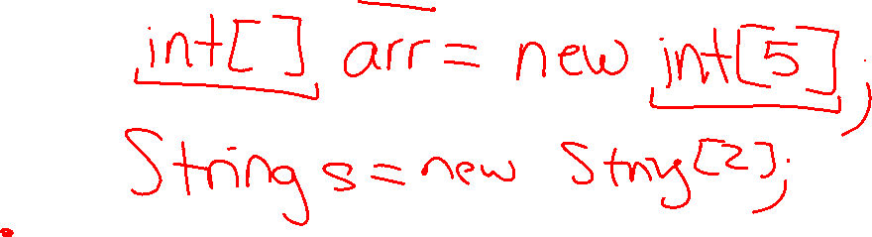
Review
Initialize an array of any type with the new keyword.

Slide 4

Introduction to 2D Arrays
A 2D array is like a table or matrix with rows and columns. A 2D array is an array of arrays where each row is its own array.
Key points about 2D arrays in Java
Fixed-size: Like a 1D array, once your create a 2D array, the number of rows and columns is fixed and cannot be changed later in the program.
Data types: 2D arrays can hold both primitive and reference data types.
AP CS A only covers Rectangular Arrays: Java allows “ragged arrays” with uneven columns, but these are outside of the AP CS A Course Scope.
Declaring and Instantiating a 2D Array with the new keyword
Declare the type of elements the 2D array variable will store using brackets [ ] [ ] after the type to denote a 2D array reference variable
Choose a name for the variable
Use the new keyword to instantiate the 2D array object
Repeat the type used in the variable declaration
Define the number of rows
Define the number of columns

Slide 5
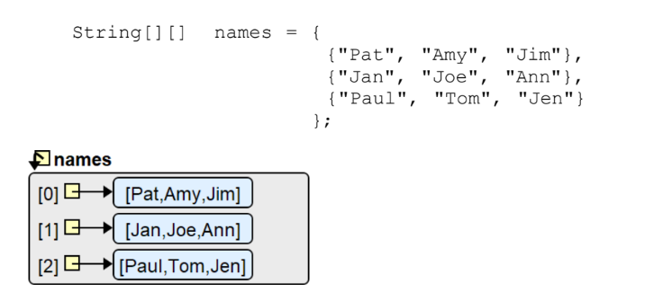
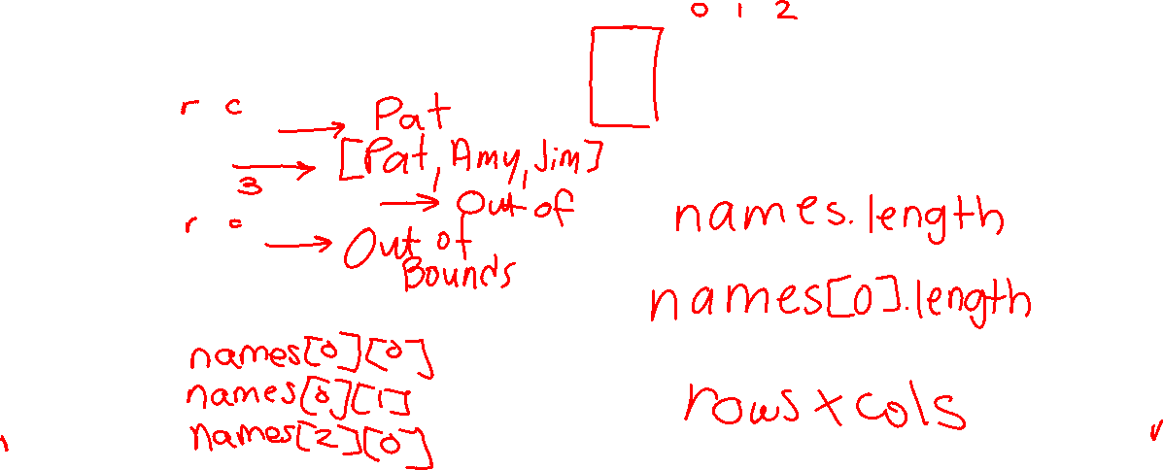
Initializing 2D Arrays
Declaring and Instantiating a 2D Array with an initializer list
Can only be done when declaring the 2D array.
What is:
names[0][0]
names[0]
names[names.length]
names[3][1]
How do you access:
“Pat”
“Amy”
“Paul”
How do you get the number of rows?
How do you get the number of columns?
How do you get the number of elements?

Slide 6
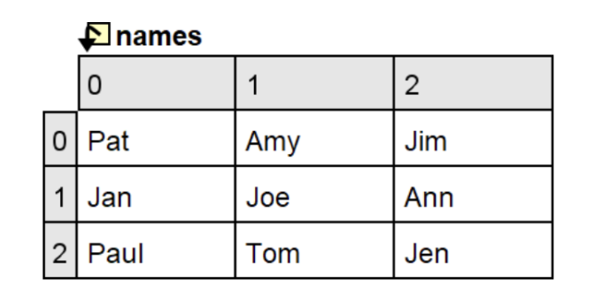
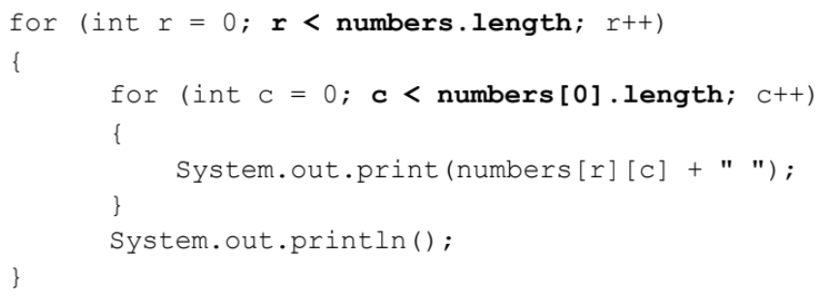
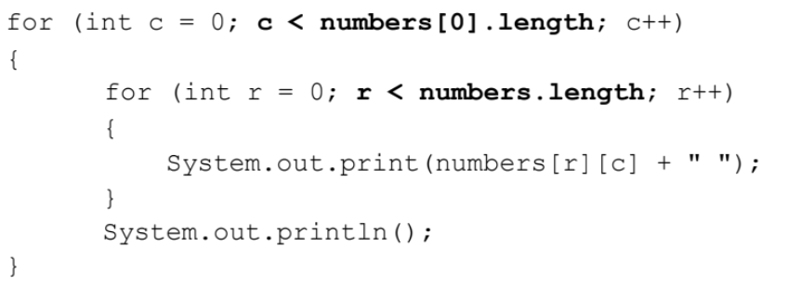
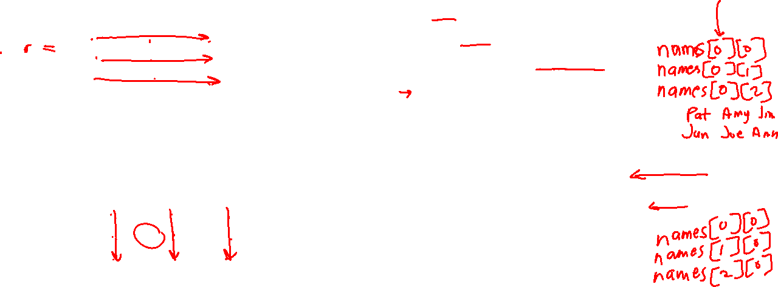
Traversing 2D Arrays
Row-major (Top-down, left-right) traversal
Column-major (Left-right, top-down) traversal

Slide 7
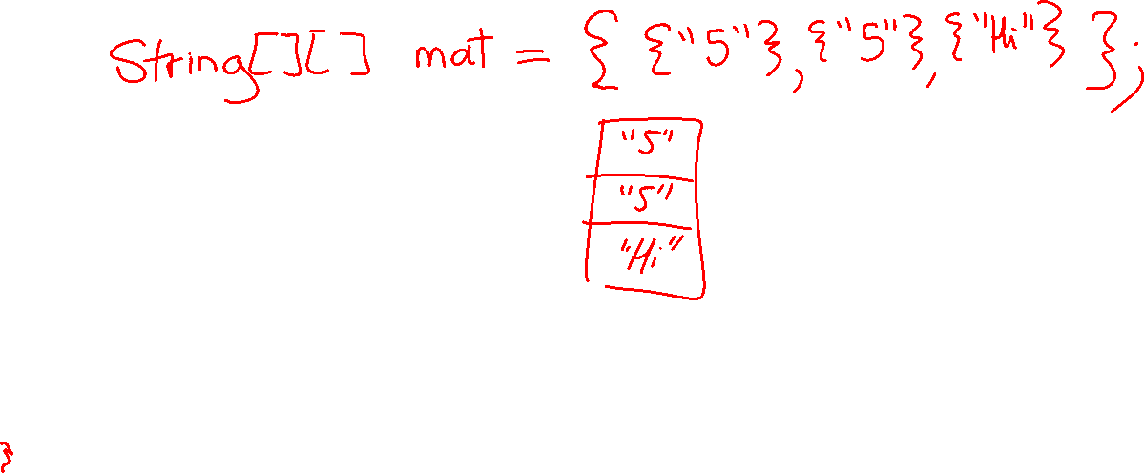
Initialize a 2D array with an initializer list

Slide 8

Initialize a 2D array with the new keyword

Slide 9
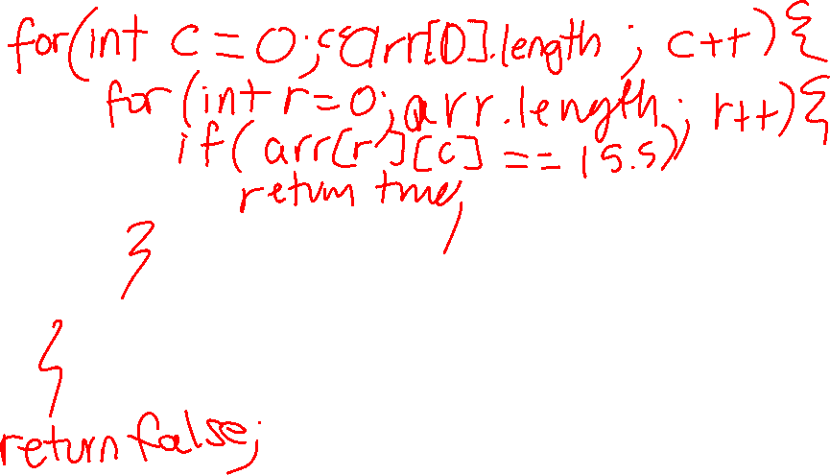
Using either row-major or column-major traversal, search a 2D array named arr of type double for the value 15.5.
Notes:
Ask for those who used row major
Ask for those who used col major

Slide 10

Draw the array that results from the initialization below: String[] names = new String[2][3];
Notes:
Ask for those who used row major
Ask for those who used col major

Slide 11
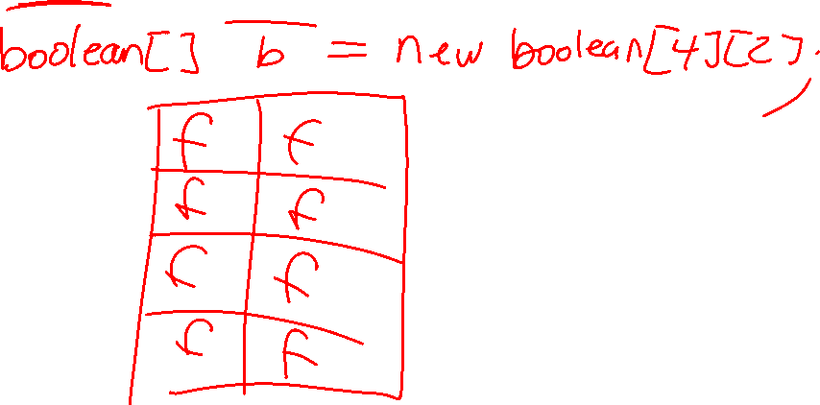
Draw the array that results from the initialization below: String[] boolean = new boolean[4][2];
Notes:
Ask for those who used row major
Ask for those who used col major

Slide 12
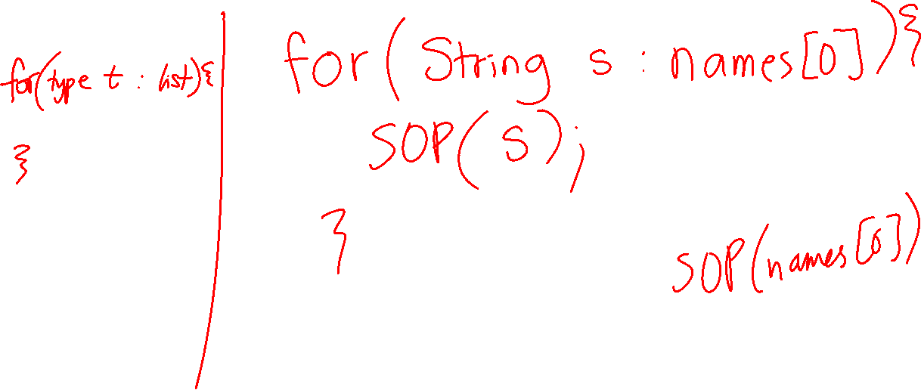
Using an enhanced for loop, print the first row of a 2D array of type String names.
Notes:
Ask for those who used row major
Ask for those who used col major

Slide 13
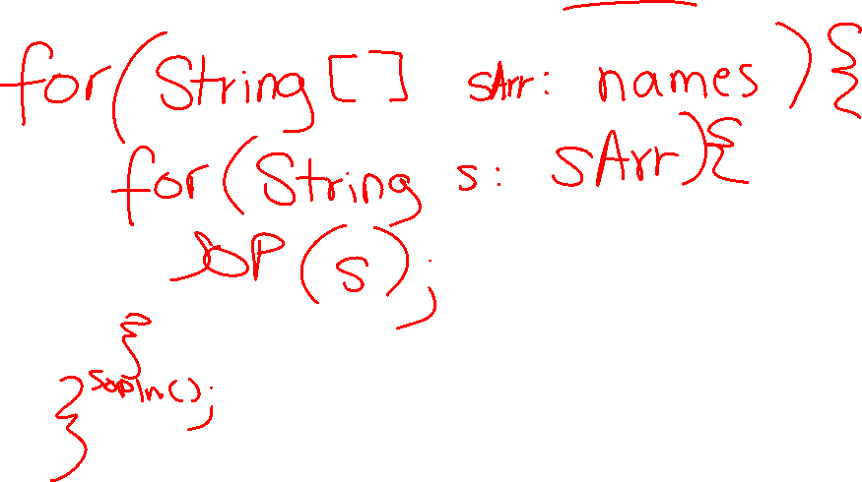
Using an enhanced for loop, print the contents of a 2D array of type String names.
Notes:
Ask for those who used row major
Ask for those who used col major

Slide 14
Worksheet Activity (Paired)
Need: Worksheet and Pencil
Jason | Justin
Nate | Juliana
Henry | David
Greydon | Elisa
Manuel | Matthew

Slide 15
Using either row-major or column-major traversal, fill a 2D array named arr of type String with empty String values.
Notes:
Ask for those who used row major
Ask for those who used col major

Slide 16
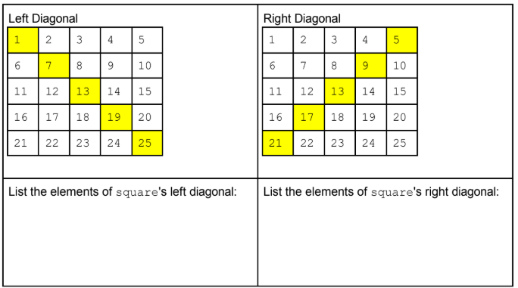
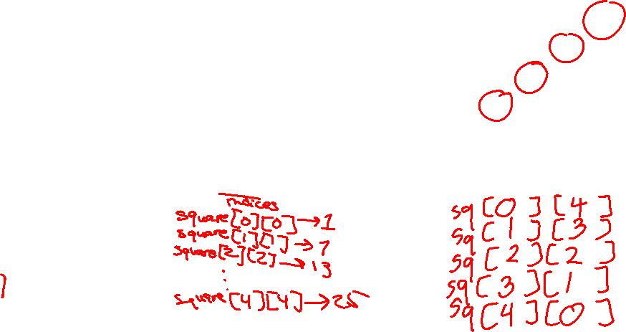
2D Array Algorithms
Accessing the Diagonals of a 2D Array
Consider the following 2D Array Declaration: int[][] square = new int[5][5];

Slide 17
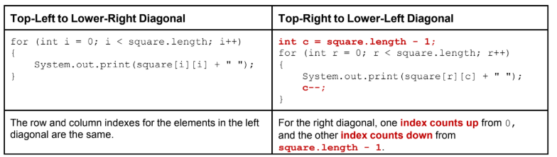
2D Array Algorithms
Accessing the Diagonals of a 2D Array
Consider the following 2D Array Declaration: int[][] square = new int[5][5];
Note: When the 2D array is not square (# rows == # cols), the for loop test must ensure both indices are valid.

Slide 18
2D Array Algorithms
Accessing the Diagonals of a 2D Array
Consider the following 2D Array Declaration: int[][] square = new int[5][5];
Note: When the 2D array is not square (# rows == # cols), the for loop test must ensure both indices are valid.

